Slide 1
IT11004: Data Representation and Organization
Floating Point Representation

Slide 2
2.5 Floating-Point Representation
The signed magnitude, 1’s complement, and 2’s complement representations as such are not useful in scientific or business applications that deal with real number values over a wide range.
Floating-point representation solves this problem.

Slide 3
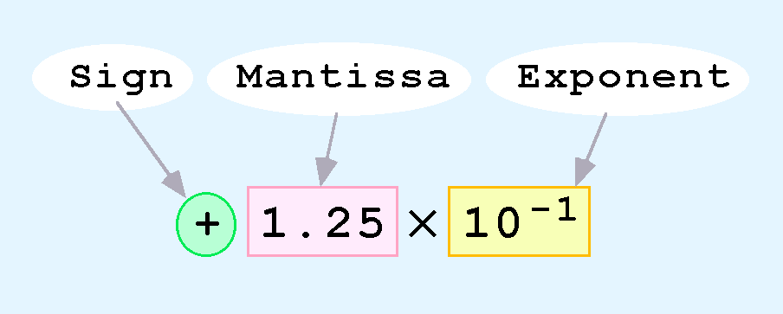
2.5 Floating-Point Representation
Computers use a form of scientific notation for floating-point representation
Numbers written in scientific notation have three components:

Slide 4
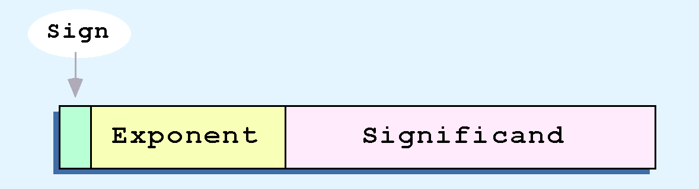
2.5 Floating-Point Representation
Computer representation of a floating-point number consists of three fixed-size fields:
This is the standard arrangement of these fields.

Slide 5
2.5 Floating-Point Representation
The one-bit sign field is the sign of the stored value.
The size of the exponent field, determines the range of values that can be represented.
The size of the significand determines the precision of the representation.

Slide 6
2.5 Floating-Point Representation
The IEEE-754 single precision floating point standard uses an 8-bit exponent and a 23-bit significand.
The IEEE-754 double precision standard uses an 11-bit exponent and a 52-bit significand.
For illustrative purposes, we will use a 14-bit model with a 5-bit exponent and an 8-bit significand.

Slide 7
2.5 Floating-Point Representation
The significand of a floating-point number is always preceded by an implied binary point.
Thus, the significand always contains a fractional binary value.
The exponent indicates the power of 2 to which the significand is raised.

Slide 8

IEEE single-precision binary floating-point format: binary32

Slide 9
convert a base 10 real number into binary32 format
consider a real number with an integer and a fraction part such as 12.375
Convert the integer part into binary
convert the fraction part using the following technique
add the two results and adjust them to produce a proper final conversion
Conversion of the fractional part
0.375 x 2 = 0.750
0.750 x 2 = 1.500
0.500 x 2 = 1.000 fraction = 0.000, terminate
(0.375)₁₀ can be exactly represented in binary as (0.011)₂
Therefore (12.375)₁₀ = (12)₁₀ + (0.375)₁₀ = (1100)₂ + (0.011)₂ = (1100.011)₂
In normalized form (12.375)₁₀ = 1.100011₂x2³

Slide 10
convert a base 10 real number into binary32 format…
In normalized form (12.375)₁₀ = 1.100011₂x2³
From which we deduce:
The exponent is 3
(and in the biased form it is therefore 127+3 =130 = 1000 0010)
The fraction is 100011 (looking to the right of the binary point)
From these we can form the resulting 32 bit IEEE 754 binary32 format representation of 12.375 as:
0-10000010-10001100000000000000000 = 41460000_{H}

Slide 11
Ex 1
0.25 x 2 = 0.5
0.5 x 2 = 1.0
∴0.25₁₀ = 0.01₂
Consider a value 0.25 .
We can see that : (0.25)₁₀ =(1.0)₂x2⁻²
From which we deduce :
The exponent is −2
(and in the biased form it is 127+(−2)= 125 = 0111 1101 )
The fraction is 0
(looking to the right of binary point in 1.0 is all zeros)
From these we can form the resulting 32 bit IEEE 754 binary32 format representation of real number 0.25 as:
0-01111101-00000000000000000000000 = 3e800000_{H}

Slide 12
Ex 2
Convert 113.21 into binary 32 floating point format

Slide 13
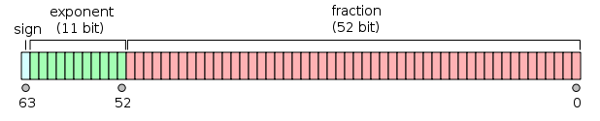
Double-precision floating-point format (binary64)
a computer number format that occupies two adjacent storage locations in computer memory.
A double-precision number, sometimes simply called a double, may be defined to be an integer, fixed point, or floating point
binary64 is having:
Sign bit: 1 bit
Exponent width: 11 bits
Significand precision: 52 bits

